Slide 1
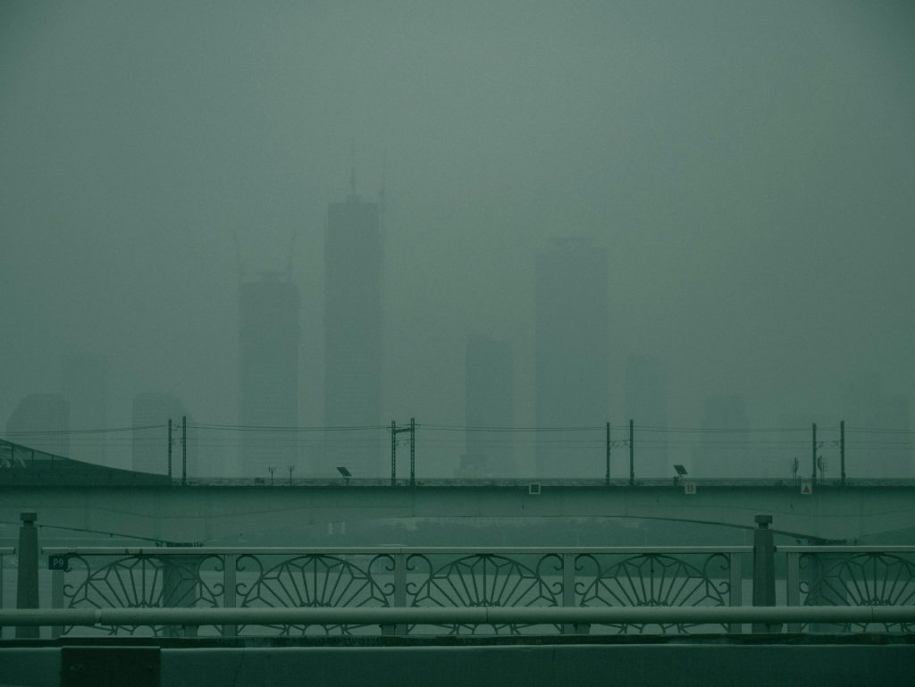
AIR QUALITY MONITORING DASHBOARD
BREATHE EASY
Term Project
202355502 BATTUMUR KHONGORZUL

Slide 2



Introduction to the Project
The Air Quality Monitoring Dashboard presents an interactive 3D globe that displays real-time air quality data for cities around the world.
Interactive 3D Globe
City search
Pollution ranking
A rotating globe that displays cities across the world.
Searching specific cities, zooming in on their location on the globe, and displaying air quality information.
Displays the top most polluted cities based on their ar quality index.

Slide 3
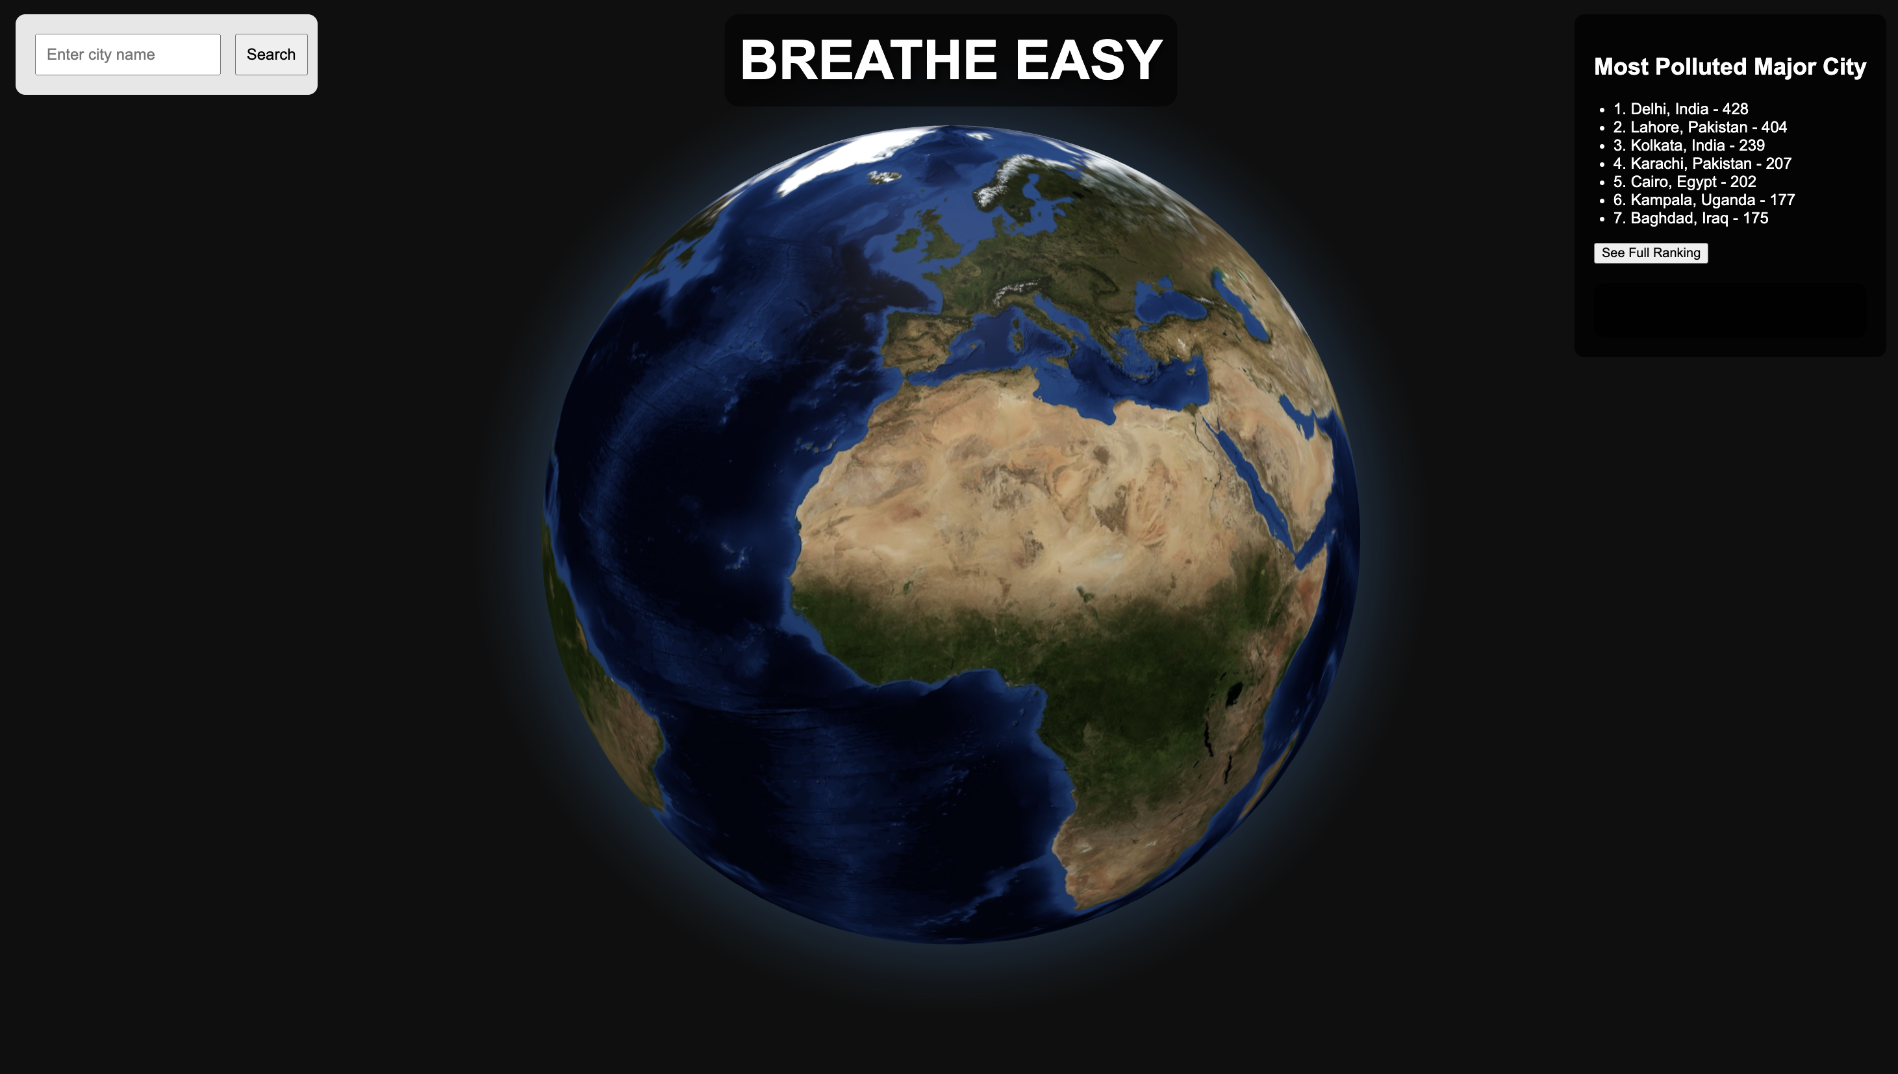
Layout of the Web Page
Header
Search cities
City ranking
Interactive Globe

Slide 4
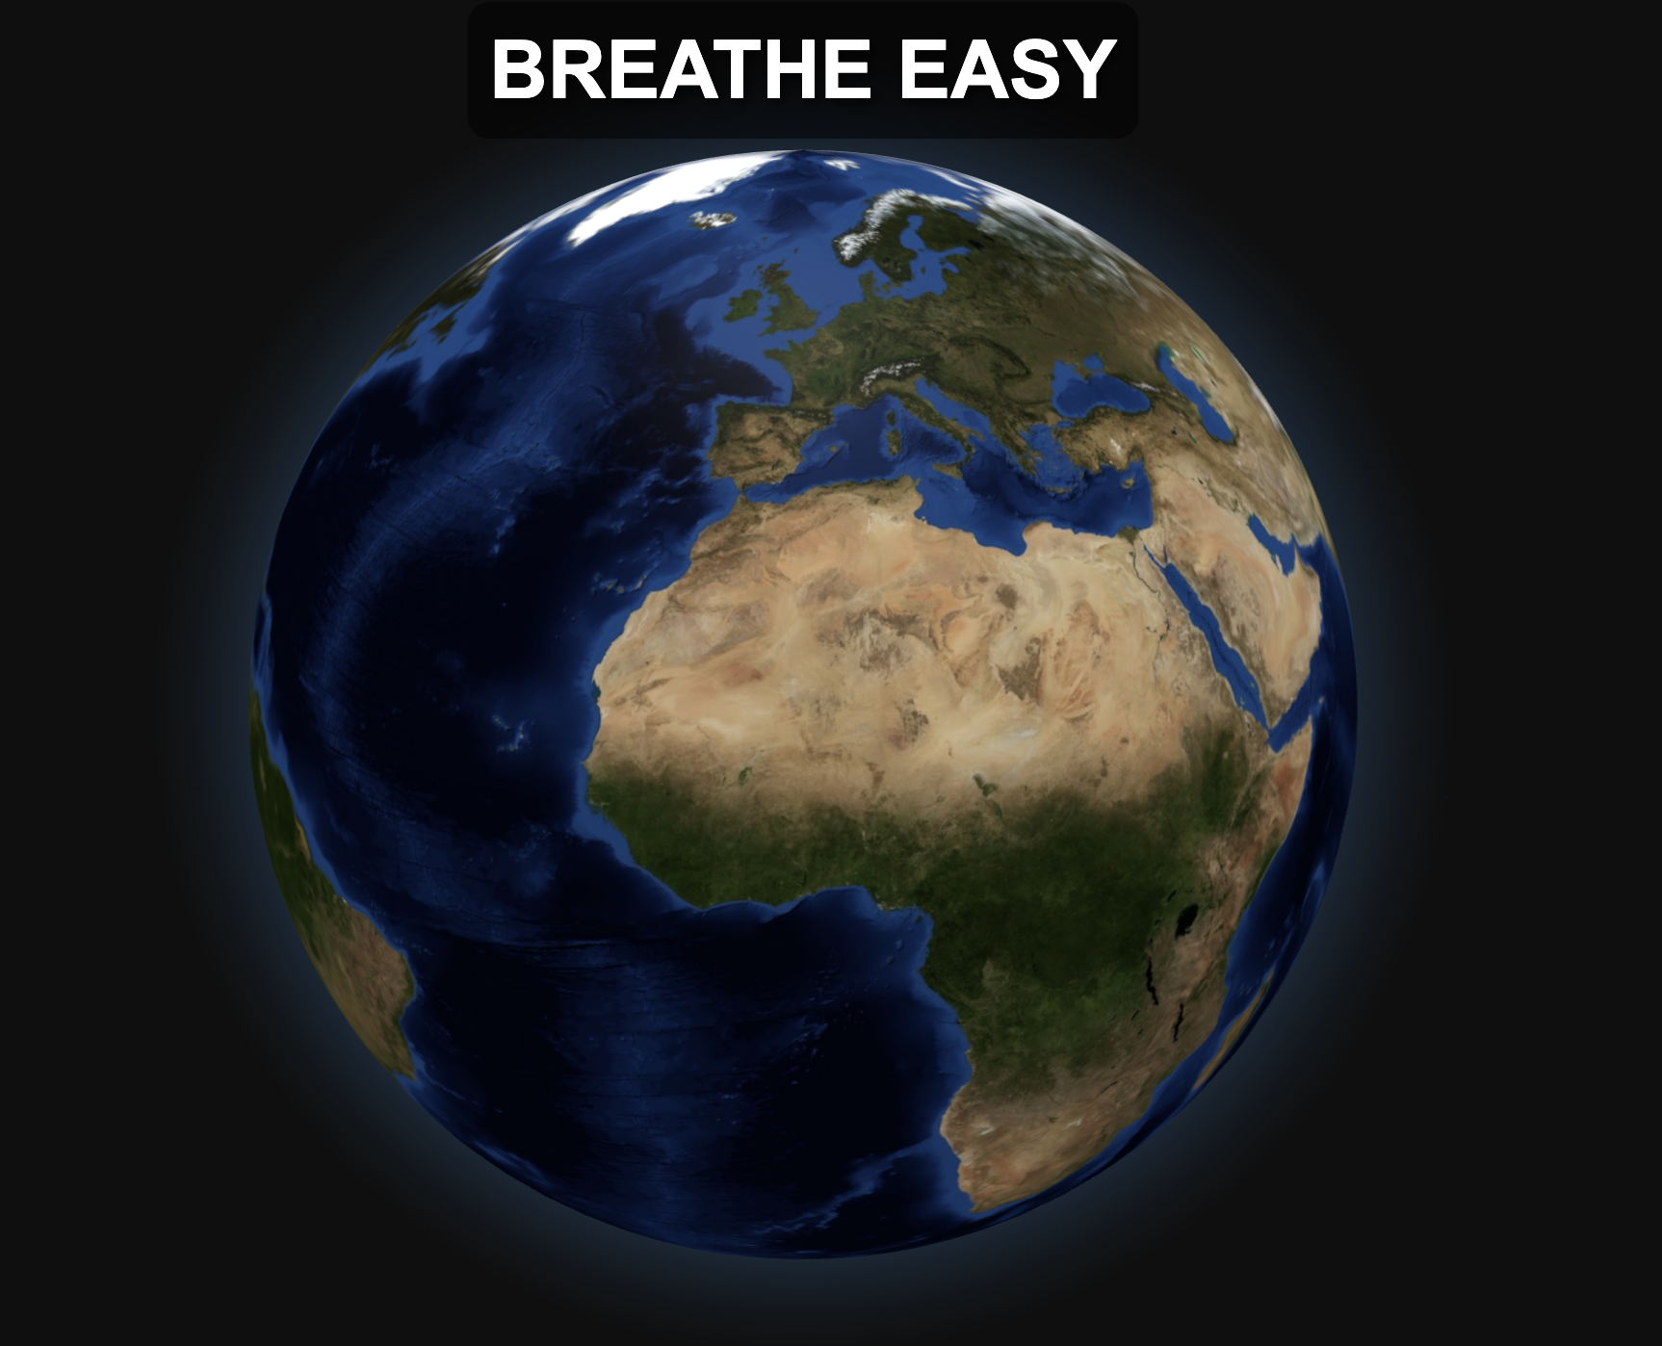
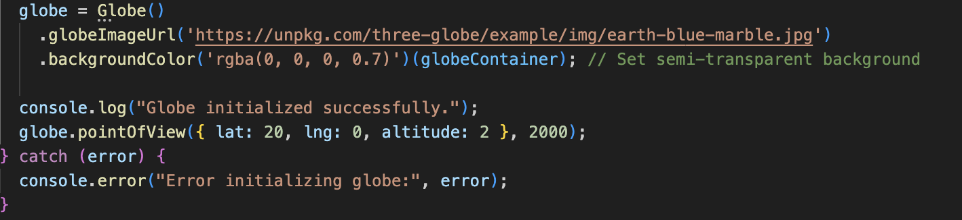
3D Interactive Globe
1. Importing the globe.gl Library
globe.gl library
Adds the functionality to create and display the 3D globe
2. Initializing the Globe
Sets up the globe with an image
texture and background color
Defines the default location and
zoom level on the globe

Slide 5
HOW THE GLOBE WORKS
01
02
03
Globe Initialization
City Search
OpenWeatherMap API
is used to search for the city and get its coordinates.
Fetch city coordinates
After a city searched, the API fetches the city’s latitude and longitude.
06
05
04
Display data
in Sidebar
Update Globe Markers
After fetching the air quality data, Globe.gl is used to display
city markers on the globe, updated
with the air quality information.
Fetch Air Quality data
OpenWeather Map Air pollution API)
is called to fetch real time air quality data
based on city’s coordinates.

Slide 6
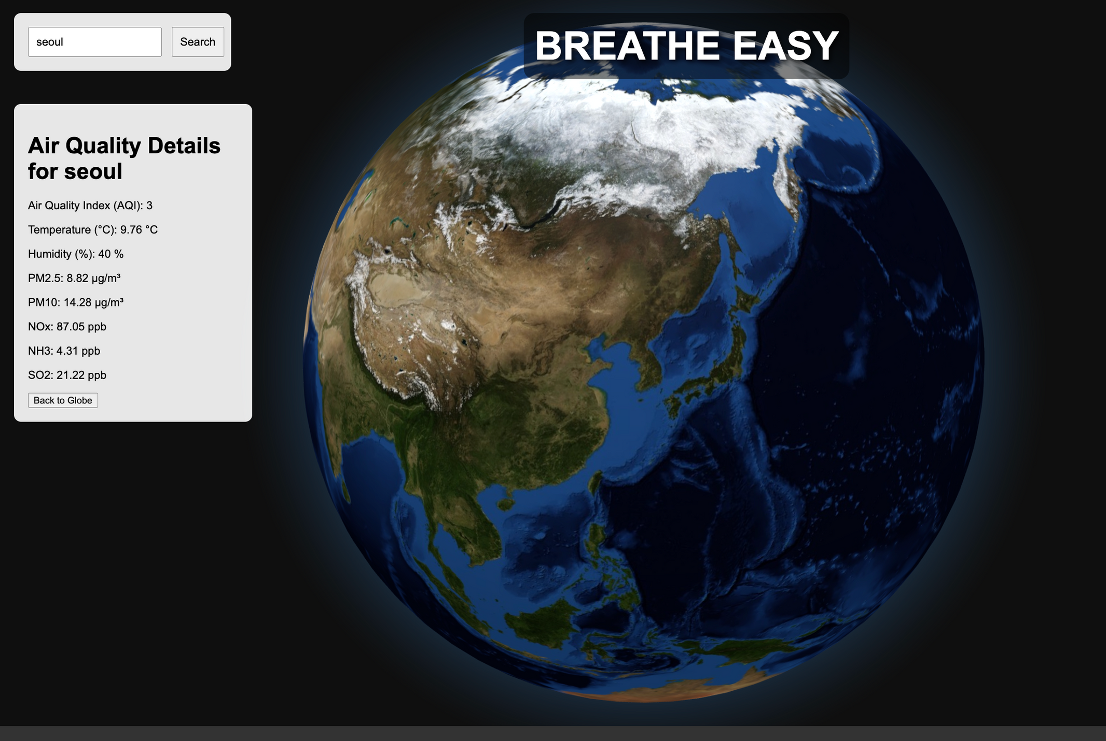
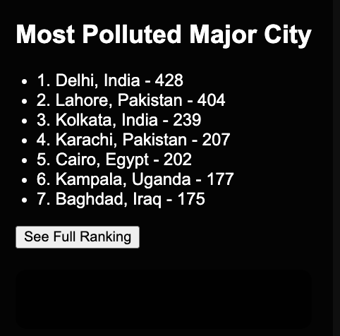
SIDEBAR LAYOUT
Search for a city
Side bar displays the real-time air quality index and other data
This section displays the top 7 most polluted cities based on their real-time Air Quality
Index. The cities are ranked from highest to
lowest AQI. AQI values are pulled from the
OpenWeatherMap Air Pollution API.

Slide 7
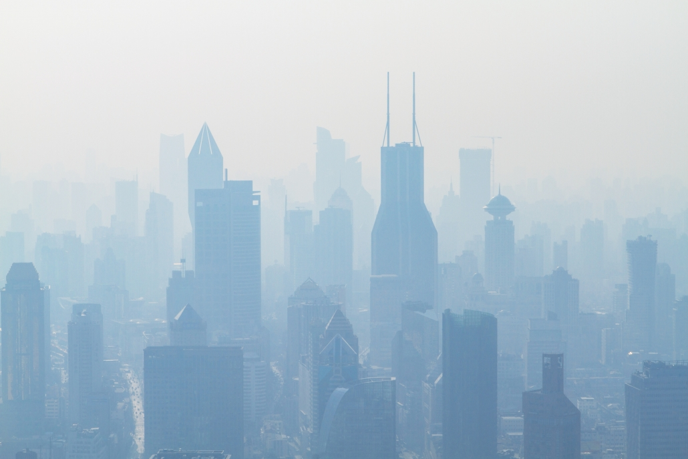
Upcoming Features &
Improvements
1. Expanded Polluted City Ranking:
Add more cities and show a full ranking on a separate page.
2. Add Country Name on Globe:
Display the country name when a city is selected on the globe
3. City Search on a Separate Page:
Search for a city leads to a new page with comprehensive data
presented through various visualizations like bar charts and more.
4. Compare with Previous Day’s Data:
Enable comparison of air quality between today and yesterday
5. Interactive Charts and Dynamic color scheme:
Introduce line, bar, and doughnut charts for visualizing air
quality trends and pollutants. Color-code markers and the sidebar
based on AQI levels (green for good, red for unhealthy).
6. Add a Navigation Bar and Footer:
Implement a navigation bar for easy access to different sections
like home, ranking, city search, and about. Include a footer at the bottom of the page.

Slide 8
END OF THE DOCUMENT
THANK YOU
https://bkhongorzul.github.io/project-code/

